Slide 1
STOVE TESTING SCHOOL
KOKO

Slide 2
INTRODUCTION
KOKO Networks is a start up venture based Business Network
Our mission is to improve life for everyone in Africa’s cities
Smartcook is the entry product for KOKO Networks into the Market

Slide 3
Objectives
By the end of this Module the learner should be able to
A) State the Importance of stove testing
B) Name the Various Types of Stove Tests
C) State Skills Required for Carrying out tests
D)Understand parts and working of the Smartcook Stove
E) Use the KOKO Testing Protocol
F) Minimize on sources of errors during Testing

Slide 4
Expected Outcomes
Appreciate the Smartcook Stove and Technology
Carry out Stove Testing
Identify areas of improvement on stove
Interpret the findings from the stove tests
Make conclusion on stove customer useability based on stove test results

Slide 5
Importance of Stove Testing
1. to know the performance of the stove in areas of time of cooking,efficiency, emissions, burnrate and firepower
2. to know areas of improvement for the stove
3. performance logging for stability of stove
4. Establish durability and safety of stove
5. Government Compliance

Slide 6
Types of Stove Tests
1. Water Boiling Test (WBT)
2. Safety Tests
3. Cooking Tests ( Controlled and Uncontrolled)
4. Kitchen Performance Tests
5. Durability Tests

Slide 7
WBT
The Water Boiling Test (WBT) is a laboratory test that evaluates stove performance while completing a standard task in a controlled environment (boiling and simmering water) to investigate the heat transfer and combustion efficiency of the stove

Slide 8
WBT
They are the easiest, quickest, and cheapest to conduct, but reveal the technical performance of a stove only under the particular case of water-boiling conditions, and not necessarily under real cooking conditions in households. They are conducted under controlled conditions by trained technicians, rather than local cooks,

Slide 9
WBT
It cannot provide insight into how the stove performs when cooking real foods under realistic conditions.
The method starts with a high-power boiling phase followed by a low-power simmering phase

Slide 10
WBT
Strengths:
simplicity,
replicability,
speed, and cost effective to conduct.
It can provide preliminary understanding of stove performance and therefore inform the design process.

Slide 11
WBT
Weaknesses:
only a rough approximation of actual cooking. Recent studies have shown that WBT are not good predictors of actual fuel use when compared to measurements in fuel use in households

Slide 12
Safety
the ten safety evaluation procedures for household biofuel cookstoves are used to evaluate safety, they are outlined below
Sharp edges and points
Cookstove tipping
Containment of Fuel
Obstructions near cooking surface
Surface temperature

Slide 13
Safety
6. Heat transfer to the environment
7. Handle Temperature
8. Chimney Shielding
9. Flames Surrounding Cookpot
10. Flames Exiting fuel chamber, canister or pipes

Slide 14
Controlled cooking Test
The Controlled Cooking Test (CCT) is a laboratory or field test that measures stove performance in comparison to traditional cooking methods when a cook prepares a local meal. The CCT is designed to assess stove performance in a controlled setting using a standard task chosen to emulate local practices

Slide 15
Controlled Cooking Tests
It reveals what is possible in households under ideal conditions but not necessarily what is actually achieved by households during daily use. It should be done by a person who is familiar with the meal being cooked, the traditional cooking methods, and the operation of the stove being tested

Slide 16
Controlled Cooking Tests
Strengths: relative simplicity, replicability, speed, and cost effective to conduct. It can provide preliminary understanding of stove performance for local cooking and therefore can be helpful through the design and dissemination process.

Slide 17
Controlled Cooking Tests
Weaknesses: controlled conditions (including fuel, food procurement and training) still do not reflect uncontrolled usage that is sensitive to operator behavior differences or fuels that vary in composition, moisture, and size

Slide 18
Kitchen performance test
The Kitchen Performance Test (KPT) is the principal field test used to evaluate stove performance in real-world settings. It is used in the homes of stove users and is designed to assess actual impacts on household fuel consumption.

Slide 19
KPT
KPTs are typically conducted in the course of a dissemination effort with local populations cooking normally, and give the best indication of real world changes. They are often conducted over several days of continuous monitoring.

Slide 20
Durability And Quality Tests
•Durability affects numerous aspects of the cookstove sector, including usability, performance, safety, and user perception
The tests seek to identify not only aspects of cookstove designs that may affect usable life, but also the larger concept of cookstove quality. Four primary aspects of cookstove quality were considered when developing the tests.

Slide 21
Quality
COMPONENTS OF QUALITY
•a) Performance – will performance and safety change as the cookstove ages?
•b) Reliability – will the cookstove continue to perform as anticipated?
•c) Durability – will the cookstove last?
d) Perceived Quality – will the customer feel, regardless of true performance that the product they have purchased is worth the price?

Slide 22
Tests
•1. Extended Run Test
•2. External Impact Test
•3. Internal Impact
•4. Corrosion Testing
•5. Coating Adhesion Testing
•6. Quenching Test
•7. Material Failure Temperature

Slide 23
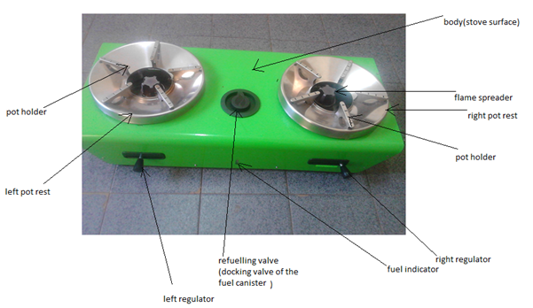
KOKO Smartcook Stove

Slide 24
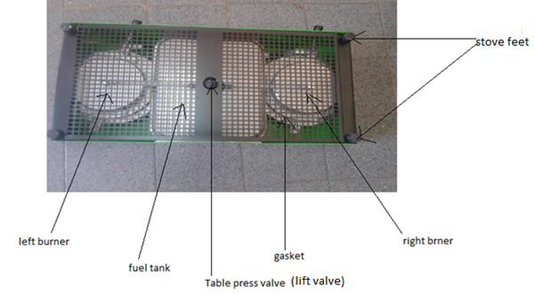
KOKO Smartcook Stove

Slide 25
Smartcook Testing Protocol
The protocol consists of the following Tests
Functionality
Safety
Efficiency
Kitchen Performance Test
Durability Tests
In this Exercise we shall Conduct Testing for the first three Tests

Slide 26
Measurements to be Taken
ambient conditions of the testing rooms
initial temperature,relative humidity,general wind conditions(light breeze,strong wind,moderate wind or no wind).
Weight of stove + fuel (initial and final weights)
water temperatures(initial and final temp)
dry weight of the cookpot
weight of the cookpot+water(2.5litres)

Slide 27
Sources of Error
Wrong Readings
Wrong Reading Angles

